Slide 1
Note Reading Basics Nigel Chapman Music

Slide 2
Index
Getting Started – Slide 3
Rhymes for the Stave Notes on the piano – Slide 13
Grade 1 Sight Reading – Slide 18
Grade 2 Sight Reading – Slide 24

Slide 3
What you need to know
Music and keyboard layout
STEP | A next door note
GAP | Miss one note
STRETCH | Miss two notes
DOUBLE GAP | Miss three notes
Up Down Same
Step Gap Stretch Double Gap
Example
Test yourself

Slide 4
What you need to know
UP DOWN SAME | STEP GAP STRETCH DOUBLE GAP
STEP | A next door note
GAP | Miss one note
STRETCH | Miss two notes
DOUBLE GAP | Miss three notes

Slide 5
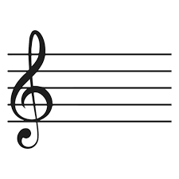
Music and keyboard layout
DOWN
SAME
UP
DOWN
UP

Slide 6
Same
3
E
This is the note E (finger 3 in the C position) Play 4 Es

Slide 7
Steps
DOWN
UP
3
E
F
G
This tune starts with 3 on E (C position) steps up and back down. A Step is a next door note

Slide 8
Gaps
UP
DOWN
5
3
1
E
G
B
This tune starts with 1 on E , gaps up to G , then B, then back down . A gap means miss one note

Slide 9
Stretch
UP
DOWN
4
1
E
A
This tune starts with 1 on E, then stretches up to 4 on A A Stretch means miss two notes

Slide 10
Double Gap
UP
DOWN
5
1
E
B
This tune starts with 1 on E, then double gaps up to 5 on B A Double gap means miss three notes

Slide 11
Example
Answers Step down Step down Gap down Step up Gap up Step up Double Gap down
5
B
5
Note reading process – Two tasks State whether the music goes up down or same Does the music changes by a step gap stretch or double gap

Slide 12
Test what you have learnt
Answers Step up Step up Gap down Step down Step down Stretch up Step up Double gap down
3
B
3
Test : This tune starts with 3 on B. Two items to identify. Does the music go up down same Does the music move by a step gap stretch doublegap

Slide 13
Rhymes for the Stave / Notes on the piano

Slide 14
Treble Clef
Mid C
B
C
E
D
E
F
G
A
F
Fast
E
Drives
L I N E S
C
Bus
A
Green
F
SPACES
Every
L I N E S
SPACES
Practice playing rhymes on the piano and

Slide 15
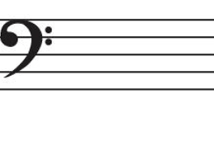
Bass clef
Mid C
G
B
E
A
C
A
D
F
G
Auntie
Grass
Fit
Eat
Don’t
SPACES
Cows
Boots
All
Grannys
L I N E S
L I N E S
SPACES
Practice playing rhymes on the piano and

Slide 16
Test : Name these notes
and find on the piano

Slide 17
Test : Name these notes
and find on the piano

